Slide 1
LONG TERM EVOLUTION (LTE)
7th Group

Slide 2
Daftar Isi
Pengantar LTE
Evolusi 1G ke 4G
Evolusi Release LTE

Slide 3
PENGANTAR LTE

Slide 4
Pengenalan LTE
Long Term Evolution adalah sebuah nama yang diberikan pada sebuah proyek dari 3gpp untuk memperbaiki standar mobile phone generasi ke 3 (3G).

Slide 5
Latar Belakang LTE
Kebutuhan akan laju data yang lebih tinggi dan efisiensi spektral yang lebih baik,
Permintaan layanan broadband yang terus meningkat,
Mahalnya spektrum,
Kebutuhan sistem Packet Switched yang teroptimisasi,
Evolusi ke All IP Network,
Kebutuhan QoS yang tinggi,
Penggunaan licensed frequency Untuk jaminan QoS,
Minimum latency,
Kebutuhan akan infrastruktur yang lebih murah,
Penyederhanaan arsitektur dan pengurangan network element.

Slide 6
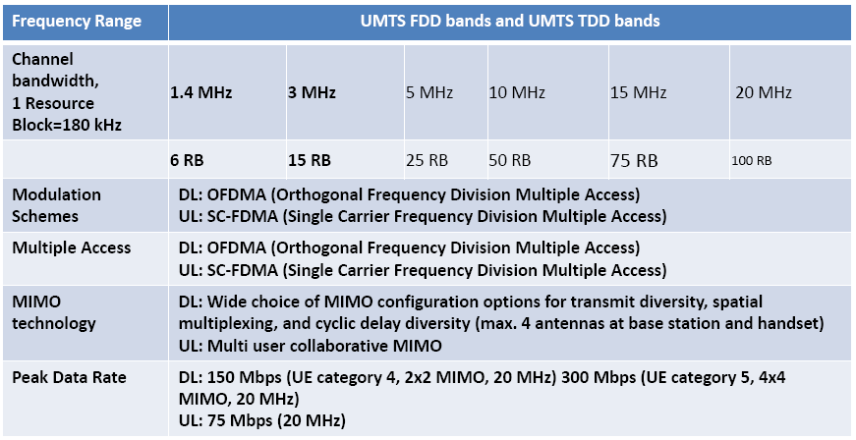
Parameter kunci LTE

Slide 7
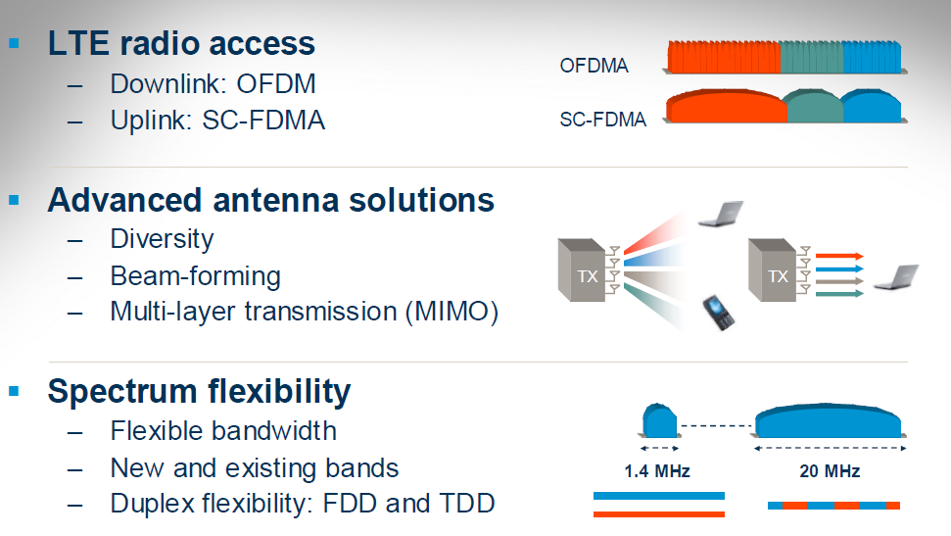
Teknologi Kunci LTE

Slide 8
Evolusi 1G ke 4g

Slide 9
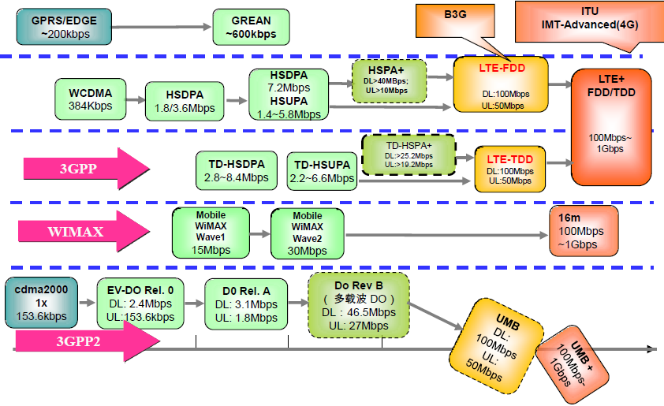

Slide 10
1g
Advance Mobile Phone System (AMPS)
Bell Labs, America, 1978, FDMA, 800MHz, 1.9 kbps
Nordic Mobile Telephony (NMT)
Finland, Sweden, Denmark, Norway 1981. NMT-450, NMT-900.
Total Access Communication System (TACS)
UK, Ireland, 1983.

Slide 11
2G
IS-95 (cdmaOne)
Global System for Mobile (GSM)
Europe,
ETSI (3GPP),
FDMA, TDMA,
900 MHz,
9,6 kbps.
America,
TIA,
DSSS,
RF 25 MHz, 1800 MHz,
153,6 kbps
2G secara Umum
Voice, 14,4 kbps (SMS)

Slide 12
2,5G
General Packet Radio Service (GPRS)
Teoritis 115 kbps, throughput 20 – 30 kbps
MMS

Slide 13
2,75G
Enhanced Data rate for GSM Evolution (EDGE)
CDMA2000
384 kbps
153 kbps

Slide 14
3G
Universal Mobile Telecommunication Service (UMTS)
Evolution-Data Optimized (EV-DO)
WCDMA
5 MHz, 1900 MHz
384 kbps 5 KHz
2.4 Mbps 1.25 MHz

Slide 15
3,5G
High Speed Packet Access (HSPA)
EV-DO Rev A
HSDPA 14 Mbps
HSUPA 5.76 Mbps
3.1 Mbps 1.25 MHz

Slide 16
3,75G
High Speed Packet Access+ (HSPA+)
EV-DO Rev B
HSDPA 84 Mbps
HSUPA 10.8 Mbps
14,7 Mbps peak rate

Slide 17
3,9G (1)
Long Term Evolution (LTE) 3GPP 2004-2005
Technical Report (TR) 25.913 “Requirements for Evolved UTRA and Evolved UTRAN (E-UTRAN)” yang mencakup diantaranya:
Peak data rate hingga 100 Mbps untuk Downlink dengan alokasi spektrum downlink 20 MHz (5 bps/Hz) dan 50 Mbps (2.5bps/Hz) untuk uplink.
Pengurangan latency pada Control-Plane maupun User-Plane
Data throughput yang meningkat 3-4 kali untuk downlink dari HSDPA Rel 6 dan 2-3 kali untuk uplink HSUPA Rel 6
Efisiensi spektrum dengan tetap dapat menggunakan lokasi pemancar yang sudah digunakan pada UTRAN/GERAN

Slide 18
3,9G (2)
Penggunaan spektrum yang fleksibel
Kemampuan mobilitas pengguna yang masih mendapatkan layanan dengan performansi tinggi pada kecepatan sampai 350 km/jam
Cakupan wilayah dengan radius 5 km untuk dapat mencapai performansi yang disebutkan di atas dan maksimum mencapai 100 km.
Enhanced MBMS (Multimedia Broadcast/ Multimedia Service)
Tetap mempertahankan 3GPP RAT (Radio Acces Technology) yang sudah ada dan mendukung interworking dengannya.
Single arsitektur yang berbasis paket, minimalisasi interdace dan penyederhanaan
Reduksi kompleksitas

Slide 19
4G IMT-Advance
Requirements
Specific requirements of the IMT-Advanced report included:
Based on an all-Internet Protocol (IP) packet switched network
Interoperability with existing wireless standards
A nominal data rate of 100 Mbit/s while the client physically moves at high speeds relative to the station, and 1 Gbit/s while client and station are in relatively fixed positions.
Dynamically share and use the network resources to support more simultaneous users per cell.
Scalable channel bandwidth 5–20 MHz, optionally up to 40 MHz
Peak link spectral efficiency of 15 bit/s/Hz in the downlink, and 6.75 bit/s/Hz in the uplink (meaning that 1 Gbit/s in the downlink should be possible over less than 67 MHz bandwidth)
System spectral efficiency of up to 3 bit/s/Hz/cell in the downlink and 2.25 bit/s/Hz/cell for indoor usage
Seamless connectivity and global roaming across multiple networks with smooth handovers
Ability to offer high quality of service for multimedia support

Slide 20
Target LTE (1)
Mendukung Bandwidth yang scalable sebesar 1.25, 2.5, 5, 10 dan 20 MHz
Puncak data rate
Downlink (2 Ch MIMO) kecepatan up to 100 Mbps pada 20 MHz channel
Uplink (tunggal Ch Tx) kecepatan up to 50 Mbps di 20 MHz
Didukung konfigurasi antenna
Downlink 4x2, 2x2, 1x2 dan 1x1
Uplink 1x2, 1x1
Efisiensi Spektrum
Downlink 3 sampai 4 x HSDPA Rel. 6
Uplink 2 sampai 3 HSUPA Rel 6

Slide 21
Target LTE (2)
Latency
C-plane <50-100 ms untuk membentuk U-plane
U-plane <10 ms dari User Equipment (UE) ke server
Mobilitas
Dioptimalkan untuk kecepatan rendah (<15 km/jam)
Target kecepatan hingga 120 km/jam
Release 10 didesain hingga 350 km/jam
Coverage area
Coverage efektif hingga 5 km
Coverage dengan sedikit degradasi 5 km -30 km
Coverage operasi dengan sampai 100 km

Slide 22
802.16

Slide 23
Background
The increasing demand for mobile broadband access to multimedia and Internet applications
Services at low cost to operators and end users.
Next-generation mobile networks Don’t just offering higher data rates and greater system efficiencies.
Service offering, and ecosystem improvement
Successful interoperability and roaming of retail devices across different networks

Slide 24
Organization
Wimax forum
Deliver certification that achieves global interoperability
Develop technical specifications based on open standards,
Pursue a favorable regulatory environment and promote the vision.

Slide 26
Technical Concept & Objectives
Orthogonal frequency-division multiple access (OFDMA)-based multiple access with scalable bandwidth in downlink and uplink
Advanced antenna technologies allowing beamforming and diversity through spacetime coding and spatial multiplexing (SM)
Adaptive physical layer (PHY) design using fast link adaptation combined with fast time and frequency scheduling
All-IP flat network architecture supporting different deployment models and enabling both traditional operator-managed as well
as new open Internet services
Open standard interfaces enabling over-the air as well as network interoperability in multivendor deployments

Slide 27
History
IEEE 802.16 Working Group established by the IEEE Standards Board in 1999
Developed and published several versions of air interface standards for wireless metropolitan area networks (WMANs)
Focus on medium access control (MAC) and PHY.

Slide 28
History (cont’d)
Initial versions of 802.16/a/d focused on fixed applications,
Latest versions — 802.16-2005 (16e) amendment and 802.16-REV2 —support enhanced quality of service (QoS) and Mobility
Focusing in 802.16m Task Group

Slide 29
History (cont’d)
The WiMAX Forum was established in 2003
Promote and enable deployment of WiMAX
Initiated several technical specification efforts to complement IEEE 802.16 standard
Defining minimum product interoperability requirements or system profiles
Protocol and radio conformance testing specifications to be used as a
Certification of devices and BSs.
Comply other standard such as IETF, 3GPP, 3GPP2, DSL Forum, and Open Mobile Alliance (OMA).

Slide 30
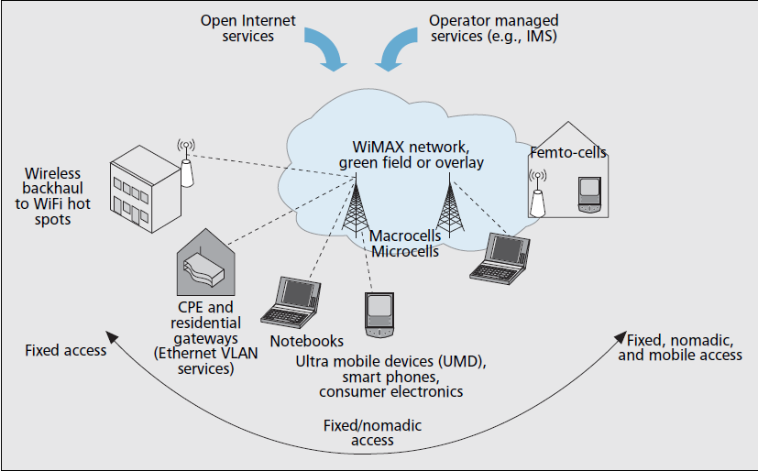
Wimax App

Slide 31
Standard | Description | Status
802.16-2001 | Fixed Broadband Wireless Access (10–66 GHz) | Superseded
802.16.2-2001 | Recommended practice for coexistence | Superseded
802.16c-2002 | System profiles for 10–66 GHz | Superseded
802.16a-2003 | Physical layer and MAC definitions for 2–11 GHz | Superseded
P802.16b | License-exempt frequencies (Project withdrawn) | Withdrawn
P802.16d | Maintenance and System profiles for 2–11 GHz (Project merged into 802.16-2004) | Merged
802.16-2004 | Air Interface for Fixed Broadband Wireless Access System (rollup of 802.16-2001, 802.16a, 802.16c and P802.16d) | Superseded
P802.16.2a | Coexistence with 2–11 GHz and 23.5–43.5 GHz (Project merged into 802.16.2-2004) | Merged
802.16.2-2004 | Recommended practice for coexistence (Maintenance and rollup of 802.16.2-2001 and P802.16.2a) | Current
802.16f-2005 | Management Information Base (MIB) for 802.16-2004 | Superseded
802.16-2004/Cor 1-2005 | Corrections for fixed operations (co-published with 802.16e-2005) | Superseded
802.16e-2005 | Mobile Broadband Wireless Access System | Superseded
802.16k-2007 | Bridging of 802.16 (an amendment to IEEE 802.1D) | Current
802.16g-2007 | Management Plane Procedures and Services | Superseded
P802.16i | Mobile Management Information Base (Project merged into 802.16-2009) | Merged
802.16-2009 | Air Interface for Fixed and Mobile Broadband Wireless Access System (rollup of 802.16-2004, 802.16-2004/Cor 1, 802.16e, 802.16f, 802.16g and P802.16i) | Current
802.16j-2009 | Multihop relay | Current
802.16h-2010 | Improved Coexistence Mechanisms for License-Exempt Operation | Current
802.16m-2011 | Advanced Air Interface with data rates of 100 Mbit/s mobile and 1 Gbit/s fixed. Also known as Mobile WiMAX Release 2 or WirelessMAN-Advanced. Aiming at fulfilling the ITU-R IMT-Advanced requirements on 4G systems. | Current[2]
P802.16n | Higher Reliability Networks | In Progress
P802.16p | Enhancements to Support Machine-to-Machine Applications | In Progress

Slide 32
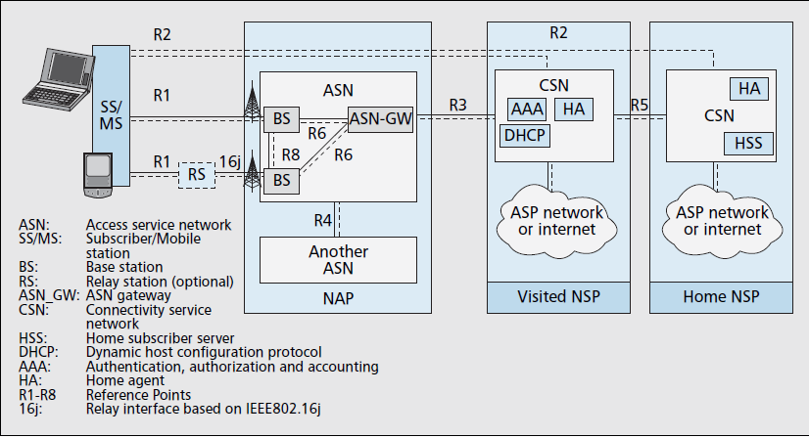
Wimax Reference model

Slide 33
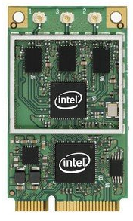
Intel chipset
IEEE 802.16e and 802.11a/b/g/n wireless
2.5GHz spectrum for WiMAX
2.4GHz and 5.0GHz spectra for WiFi
13Mbps¹ downlink and 3Mbps¹ uplink over WiMAX
up to 450Mbps Tx/Rx² over WiFi.
embedded in new Intel® Centrino® 2 processor technology notebooks

