Slide 1
ARSITEKTUR DASAR SISTEM SELULER

Slide 2
BSS = Base Station Subsystem
NSS = Network Switching Subsystem
NMS = Network Management Subsystem

Slide 3
Sistem Seluler Analog ( 1G)
Mulai berkembang pertengahan tahun 1980.
Contoh teknologi:
Advanced Mobile Phone System (AMPS) di Amerika;
Nordic Mobile Telephone (NMT) di Inggris;
Total Access Communications System (TACS) di beberapa negara Eropa.
Sistem mirip, tetapi tidak saling compatible
Frequency band di range 800 - 900 MHz (NMT = 450 MHz)
FDMA

Slide 4
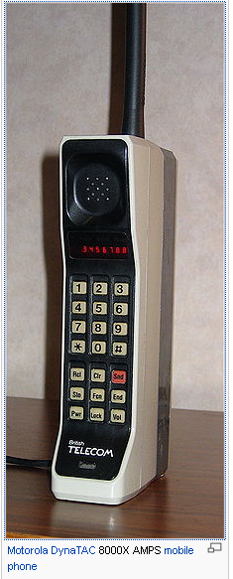
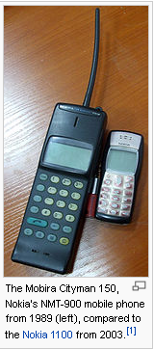
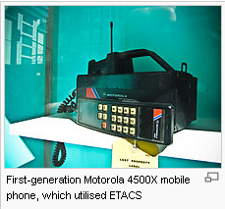

Slide 5
Sistem Seluler Digital (2G)
Berkembang tengah tahun 1990
Contoh:
GSM
CDMA (IS-95)

Slide 6
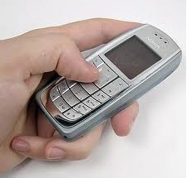
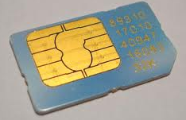
GSM (Global System for Mobile Communication)
2 teknologi berbasis GSM:
DCS-1800 (Digital Selular System 1800MHz) → Eropa, 1,8GHz band
GSM-1900 → Amerika, 1,9 GHz band
MS = SIM(Subscriber Identity Modul) + ME(Mobile Equipment)

Slide 7
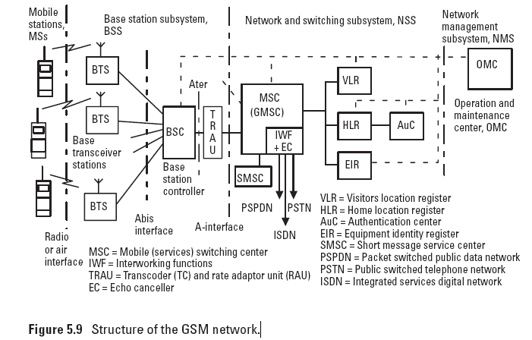
STRUKTUR JARINGAN GSM

Slide 8
MSC
the MSC establishes calls by switching the incoming channels into outgoing channels.
It also controls the communications, releases connections, and collects charging information.

Slide 9
HLR
All subscriber parameters for each mobile user are permanently stored in one HLR.
The HLR provides a well-known and fixed location for variable routing information.
The main functions of the HLR are as follows:
Storage of the subscriber data, for example, services available for this subscriber;
Location registration and call handling, central store for subscriber location data;
Support for encryption and authentication;
Handling of supplementary services (e.g., barring or call transfer);
Support for the short message service.

Slide 11
VLR
The VLR provides local storage for all of the variables and functions needed to handle calls to and from the mobile subscribers in the area related to that VLR.
The information is stored in the VLR as long as the mobile station stays in that area.
The main functions of the VLR are as follows:
Storage of data for subscribers located in its area;
Management and allocation of the local identity codes to avoid frequent use of a global identity on the radio path for security reasons;
Location registration and call handling;
Authentication;
Support of encryption;
Support for handover;
Handling of supplementary services;
Support for SMS.

Slide 13
AuC
The security data of a subscriber are stored in the AuC that contains a subscriber-specific security key, encryption algorithms, and a random generator.
The AuC produces subscriber-specific security data with defined algorithms and gives it to the HLR, which distributes them to the VLR.

Slide 14
EIR
The EIR is a database that contains information about mobile terminal equipment.
There is a white list for the terminals that are allowed to use the service, a gray list for terminals that need to be held under surveillance, and a black list for stolen mobile terminals.
Those terminals whose serial numbers are found on the black list are not allowed to use the network.

Slide 15
Transcoder and Rate Adapter Unit (TRAU)
A transcoder (TC) is needed to make conversions between GSM voice coding (13 or 7 Kbps) and PCM coding (64 Kbps), which is used in the fixed network.
In the case of data transmission, transcoding is disabled. For data, a rate adapter unit (RAU) is needed to adapt MS data service to service provided by the external network.
The functions of the TC and RAU are often combined into a single piece of equipment called a transcoder and rate adapterunit (TRAU).

Slide 16
IWF
It enables interworking between a PLMN and a fixed network, for example, an ISDN, a PSTN, and a public switched data network.

Slide 18
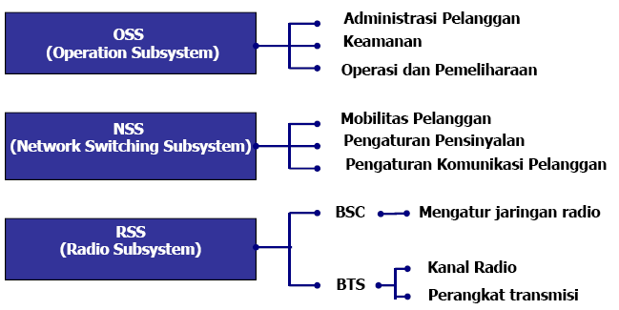
Fungsi Subsistem GSM

Slide 19
Interface di Jaringan GSM
The interface between the MSC and BSC is called the A-interface It is standardized and BSSs and MSCs from different vendors at the opposite side of the interface are compatible. Speech is PCM coded at this interface.
Another important interface is the Abis-interface between the BTS and BSC. At this interface speech is GSM coded, which requires less transmission capacity than the PCM coding.
The Abis-interface is not completely standardized and, as a consequence, both BTSs and BSCs have to be purchased from the same manufacturer. The Ater-interface is not standardized either but it is used for terrestrial connections between the BSC and MSC.
Speech is GSM coded at the Ater-interface and the transmission 216 Introduction to Telecommunications Network Engineering capacity needed at the Ater-interface is one-fourth of the capacity of the A-interface.

Slide 20
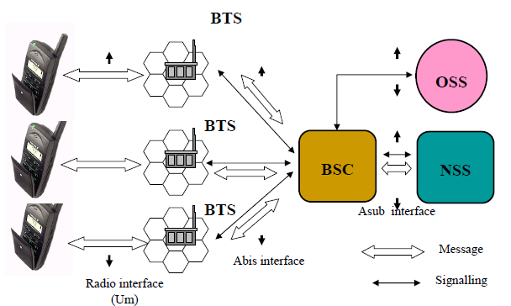
GSM Architecture

Slide 21
Perangkat BTS

Slide 25
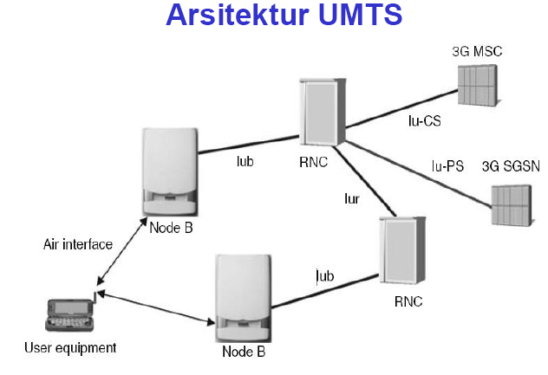

Slide 26
