Slide 1
SECURE WIRELESS LAN
Keamanan Jaringan
Program Studi Teknik Telekomunikasi
Fakultas Teknik Elektro
Telkom University
2017

Slide 2
KERANGKA
What’s Wireless LAN
Security History
Main WEP Vulnerabilities
WLAN Security Enhancement
Summary

Slide 3
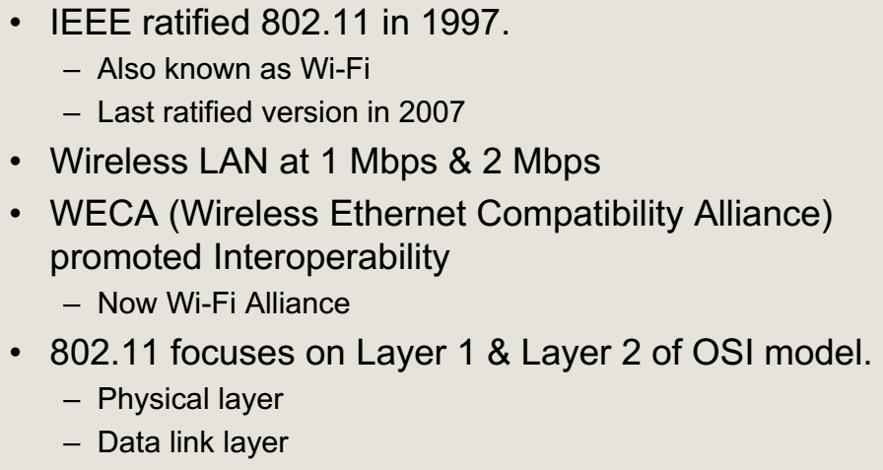
WIRELESS LAN

Slide 4
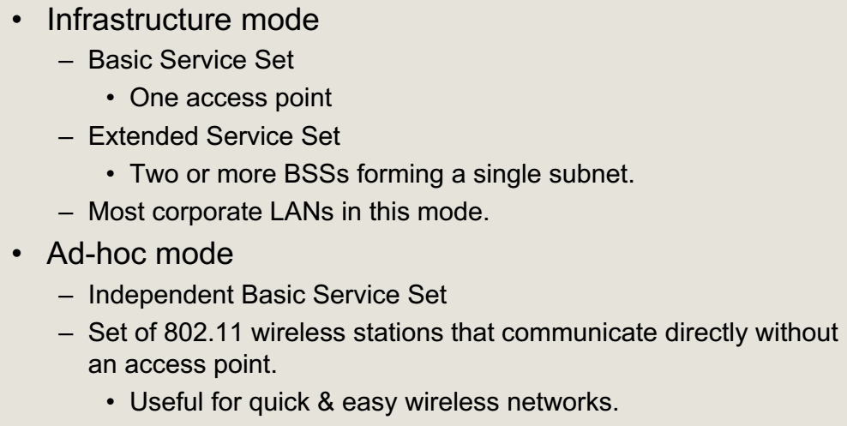
WIRELESS LAN (MODE)

Slide 5
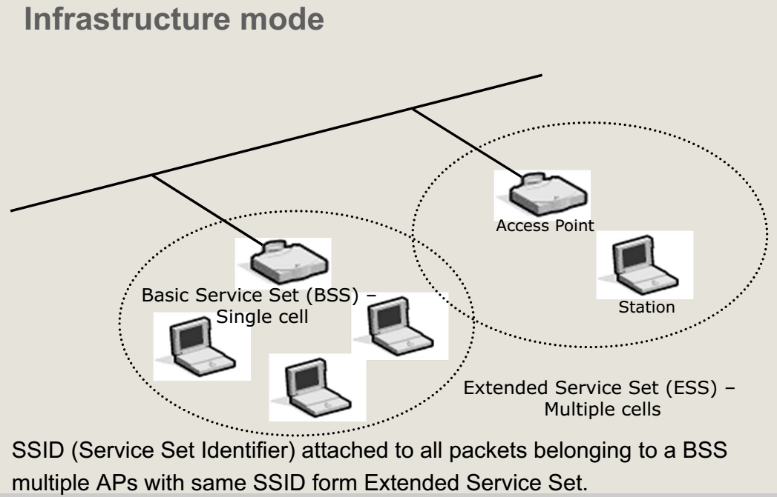
WIRELESS LAN (MODE)

Slide 6
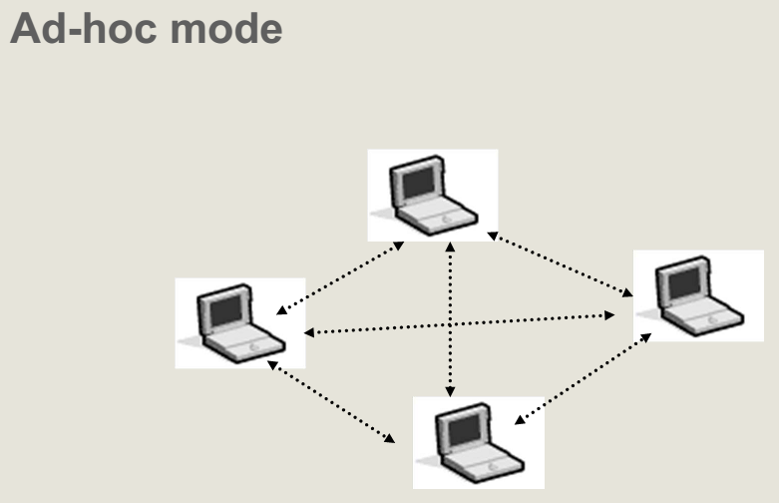
WIRELESS LAN (MODE)

Slide 7
WLAN SECURITY

Slide 8
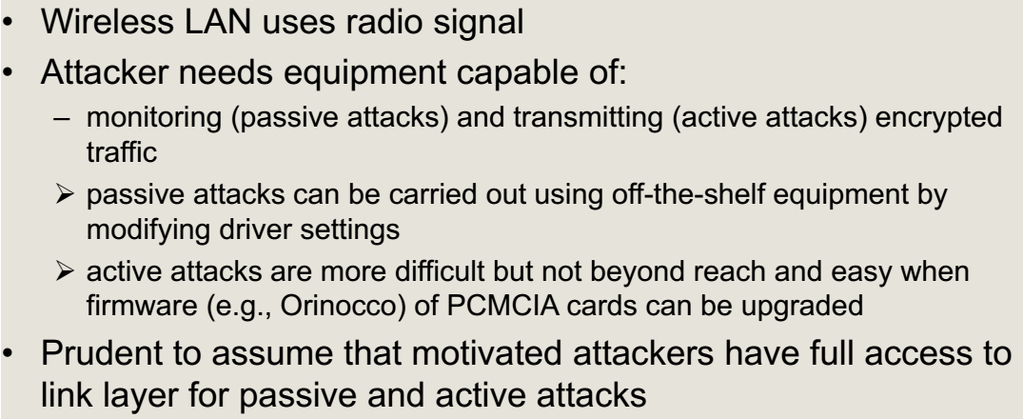
SEJARAH KEAMANAN WLAN

Slide 9
SEJARAH KEAMANAN WLAN (LAYANAN KEAMANAN 802.11B)

Slide 10
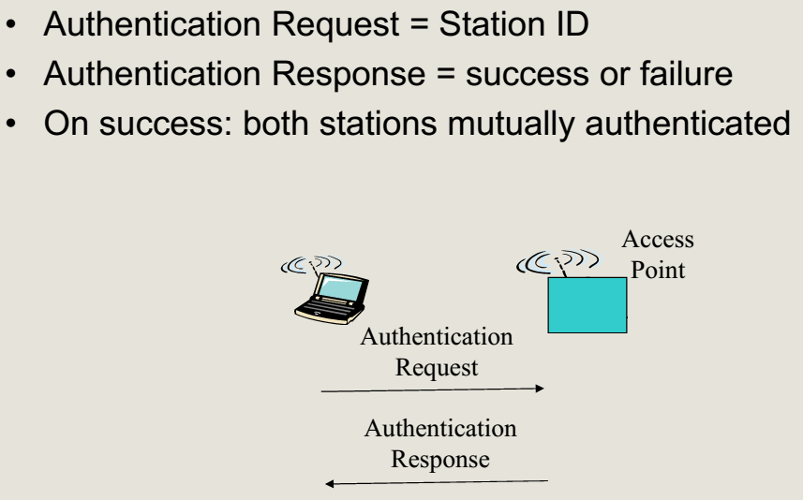
SEJARAH KEAMANAN WLAN (OTENTIKASI SISTEM TERBUKA)

Slide 11
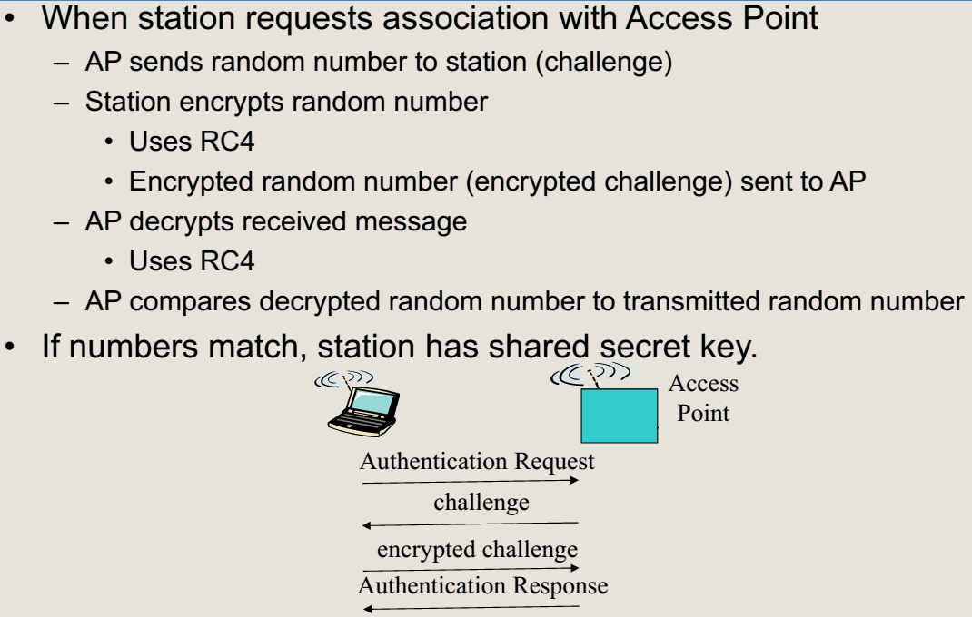
SEJARAH KEAMANAN WLAN (OTENTIKASI SHARED KEY)

Slide 12
SEJARAH KEAMANAN WLAN (WIRED EQUIVALENT PRIVACY)

Slide 13
KEAMANAN WLAN (KODE RON NOMOR 4)

Slide 14
KEAMANAN WLAN (KODE RON NOMOR 4)
Pseudocode algoritma RC4
i, j = 0;
while (true) {
i = (i + 1) mod 8;
j = (j + S[i]) mod 8;
Swap (S[i], S[j]);
t = (S[i] + S[j]) mod 8;
k = S[t]; }

Slide 15
KEAMANAN WLAN (PENGIRIMAN WEP)

Slide 16
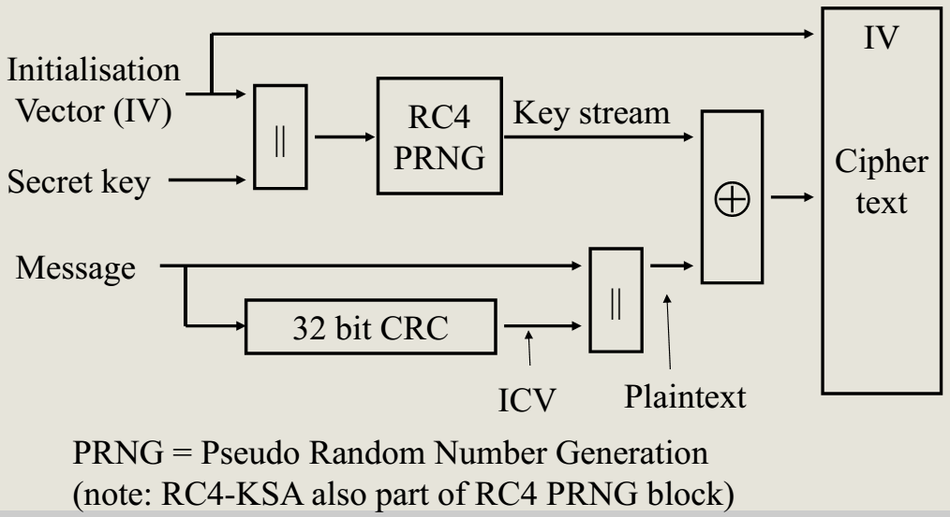
KEAMANAN WLAN (ENKRIPSI WEP)

Slide 17
KEAMANAN WLAN (PENERIMAAN WEP)

Slide 18
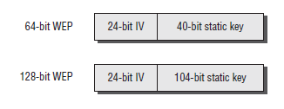
Static WEP Encryption Key and Initialization Vector (1)
64-bit WEP
a secret 40-bit static key
a 24-bit number Initialization Vector (IV)
128-bit WEP
a secret 104-bit static key
a 24-bit number Initialization Vector (IV)

Slide 19
Static WEP Encryption Key and Initialization Vector (2)
A static WEP key can be entered as hexadecimal (hex) characters (0–9 and A–F) or ASCII characters.
The static key must match on both the access point and the client device.
Not all client stations or access points support both hex and ASCII.
A 40-bit static key consists of 10 hex characters or 5 ASCII characters.
A 104-bit static key consists of 26 hex characters or 13 ASCII characters.
Initialization Vector (IV) is sent in cleartext and is different on every frame.

Slide 20
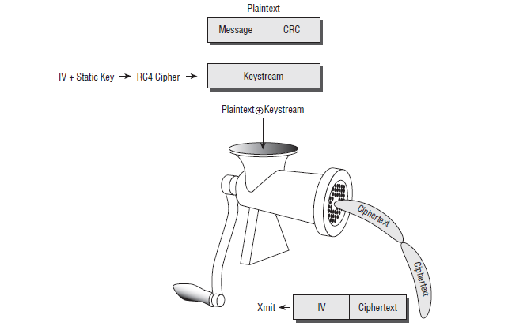
How does WEP work? (1)

Slide 21
How does WEP work? (2)
WEP runs a cyclic redundancy check (CRC) on the plaintext data that is to be encrypted and then appends the Integrity Check Value (ICV) to the end of the plaintext data.
A 24-bit cleartext Initialization Vector (IV) is then generated and combined with the static secret key.
WEP then uses both the static key and the IV as seeding material through a pseudo-random algorithm that generates random bits of data known as a keystream.

Slide 22
How does WEP work? (3)
The pseudo-random bits in the keystream are then combined with the plaintext data bits using a Boolean XOR process.
The end result is the WEP ciphertext, which is the encrypted data. The encrypted data is then prefixed with the cleartext IV.

Slide 23
KELEMAHAN WEP (SERANGAN WEP PASIF)
Buktikan!

Slide 24
SERANGAN WEP PASIF

Slide 25
KELEMAHAN IV

Slide 26
SERANGAN WEP AKTIF
Mengapa?

Slide 27
PENGUATAN KEAMANAN WLAN
WI-FI PROTECTED ACCESS

Slide 28
PENGUATAN KEAMANAN WLAN

Slide 29
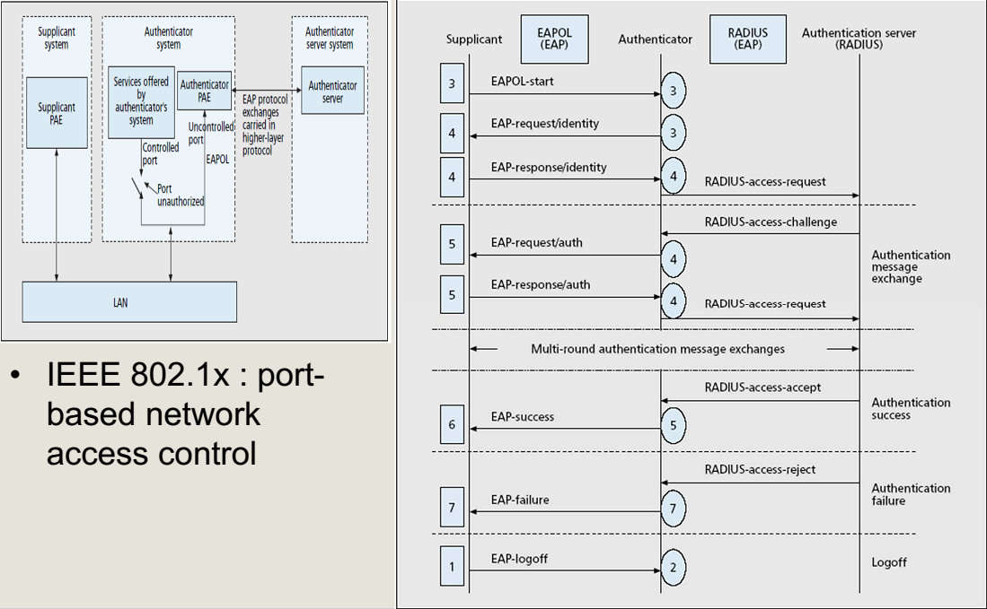
PENGUATAN KEAMANAN WLAN (IEEE 802.1X)

Slide 30
PENGUATAN KEAMANAN WLAN (IEEE 802.1x)

Slide 31
PENGUATAN KEAMANAN WLAN (WPA)

Slide 32
TKIP
Data Transfer
TKIP: Temporal Key Integrity Protocol
Designed as a wrapper around WEP
Can be implemented in software
Reuses existing WEP hardware
Runs WEP as a sub-component
Meets criteria for a good standard: everyone unhappy with it

Slide 33
TKIP design challenges
Data Transfer
Mask WEP’s weaknesses…
Prevent data forgery
Prevent replay attacks
Prevent encryption misuse
Prevent key reuse
… On existing AP hardware
33 or 25 MHz ARM7 or i486 already running at 90% CPU utilization before TKIP
Utilize existing WEP off-load hardware
Software/firmware upgrade only
Don’t unduly degrade performance

Slide 34
TKIP MPDU Format
Data Transfer

Slide 35
TKIP Keys
Data Transfer
TKIP Keys
1 128-bit encryption key
AP and STA use the same key
TKIP’s per-packet key construction makes this kosher
2 64-bit data integrity keys
AP, STA use different keys for transmit

Slide 36
TKIP Design (1) -- Michael
Data Transfer
Protect against forgeries
Must be cheap: CPU budget ≤ 5 instructions/byte
Unfortunately is weak: a 2²⁹ message attack exists
Computed over MSDUs, while WEP is over MPDUs
Uses two 64-bit keys, one in each link direction
Requires countermeasures: rekey on active attack, rate limit rekeying
DA
SA
Payload
8 byte MIC
Michael
Authentication Key

Slide 37
TKIP Countermeasures
Data Transfer
Check CRC, ICV, and IV before verifying MIC
Minimizes chances of false positives
If MIC failure, almost certain active attack underway
If an active attack is detected:
Stop using keys
Rate limit key generation to 1 per minute

Slide 38
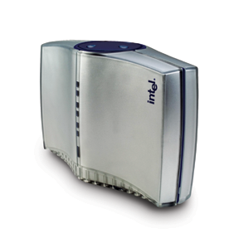
TKIP Design (3)
Data Transfer
Protect against replay
reset packet sequence # to 0 on rekey
increment sequence # by 1 on each packet
drop any packet received out of sequence
Hdr
Packet n
Wireless Station
Hdr
Packet n + 1
Access Point
Hdr
Packet n

Slide 39
TKIP Design (4)
Data Transfer
Stop WEP’s encryption abuse
Build a better per-packet encryption key…
… by preventing weak-key attacks and decorrelating WEP IV and per-packet key
must be efficient on existing hardware
Intermediate key
Phase 1
Mixer
Base key
Phase 2
Mixer
Transmit Address: 00-A0-C9-BA-4D-5F
Per-packet key
4 msb
Packet Sequence #
2 lsb

Slide 40
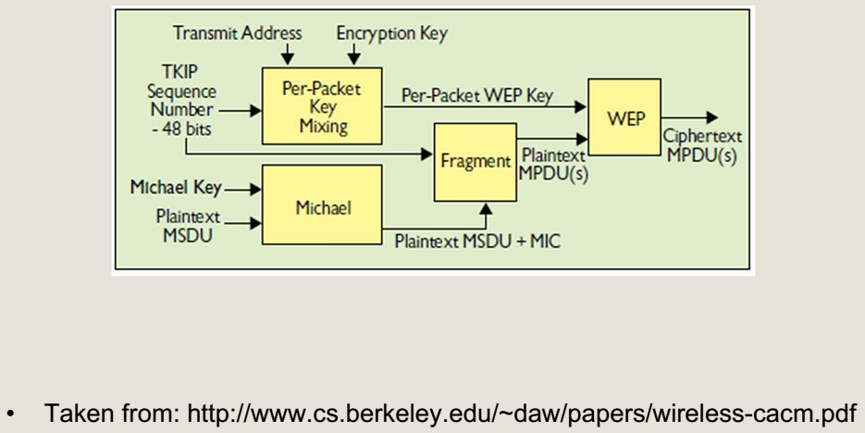
PENGUATAN KEAMANAN WLAN (WPA)

Slide 41
PENGUATAN KEAMANAN WLAN (WPA)

Slide 42
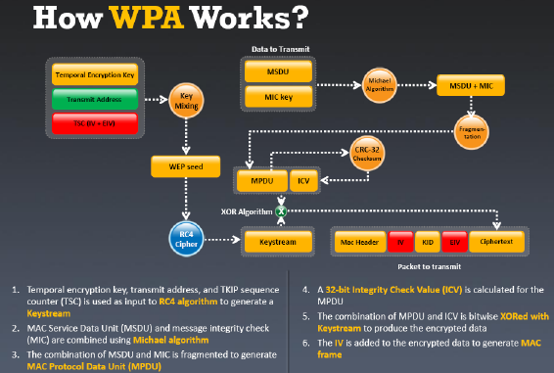
How does WPA work?

Slide 43
How WPA Addresses The WEP Vulnerability
WPA wraps RC4 cipher engine in four new algorithms
1. Extended 48-bit IV and IV Sequencing Rules
2^48 is a large number! More than 500 trillion
Sequencing rules specify how IVs are selected and verified
2. A Message Integrity Code (MIC) called Michael
Designed for deployed hardware
Requires use of active countermeasures
3. Key Derivation and Distribution
Initial random number exchanges defeat man-in-the-middle attacks
4. Temporal Key Integrity Protocol generates per- packet keys

Slide 44
PENGUATAN KEAMANAN WLAN (SERANGAN WPA PRAKTIS)

Slide 45
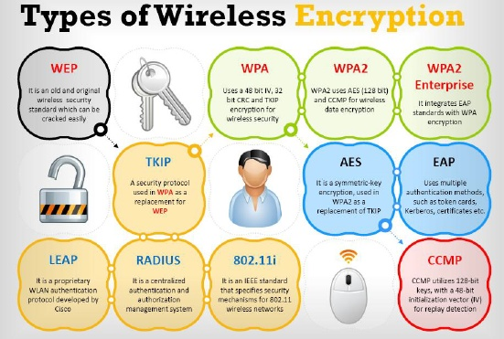
Resume (1)

Slide 46
Resume (2)

Slide 47
LAYERED SECURITY
OVERVIEW

Slide 48
Example security protocols
Application layer: PGP
Transport layer: SSL/TLS
Network layer: IPsec
Data link layer: IEEE 802.11
Security at the physical layer?

Slide 49
Security in what layer?
Depends on the purpose…
What information needs to be protected?
What is the attack model?
Who shares keys in advance?
Should the user be involved?
E.g., a network-layer protocol cannot authenticate two end-users to each other
An application-layer protocol cannot protect IP header information
Also affects efficiency, ease of deployment, etc.

Slide 50
Generally…
When security is placed as lower levels, it can provide automatic, “blanket” coverage…
…but it can take a long time before it is widely adopted
When security is placed at higher levels, individual users can choose when to use it…
…but users who are not security-conscious may not take advantage of it

Slide 51
Note…
The “best” solution is not necessarily to use PGP over IPsec!
Would have been better to design the Internet with security in mind from the beginning…

Slide 52
Example: PGP vs. SSL vs. IPsec
PGP is an application-level protocol for “secure email”
Can provide security on “insecure” systems
Users choose when to use PGP; user must be involved
Alice’s signature on an email proves that Alice actually generated the message, and it was received unaltered; also non-repudiation
In contrast, SSL would secure “the connection” from Alice’s computer; would need an additional mechanism to authenticate the user
Communication with off-line party (i.e., email)

Slide 53
Example: PGP vs. SSL vs. IPsec
SSL sits at the transport layer, “above” TCP
Packet stream authenticated/encrypted
End-to-end security, best for connection-oriented sessions (e.g., http traffic)
User does not need to be involved
The OS does not have to change, but applications do if they want to communicate securely
If TCP accepts a packet which is rejected by SSL, then TCP will reject the “correct” packet (detecting a replay) when it arrives!
SSL must then close the connection…

Slide 54
Example: PGP vs. SSL vs. IPsec
IPsec sits at the network layer
Individual packets authenticated/encrypted
End-to-end or hop-by-hop security
Best for connectionless channels
Need to modify OS
All applications are “protected” by default, without requiring any change to applications or actions on behalf of users
Only authenticates hosts, not users
User completely unaware that IPsec is running

Slide 55
IPSec Overview
IPsec can provide security between any two network-layer entities
host-host, host-router, router-router
Used widely to establish VPNs
IPsec encrypts and/or authenticates network-layer traffic, and encapsulates it within a standard IP packet for routing over the Internet

Slide 56
IPSec Overview
IPsec consists of two components
IKE --- Can be used to establish a key
AH/ESP --- Used to send data once a key is established (whether using IKE or out-of-band)
AH
Data integrity, but no confidentiality
ESP
Data integrity + confidentiality
(Other differences as well)

Slide 57
REFERENCES
A. Pras, P.T. Boer, A. Sperotto, R. Sadre, “Secure Wireless LAN”, University of Twente, 2012
J. Katz, “Computer and Network Security”, University of Maryland, Spring 2012
W. Stallings, “Cryptography and Network Security”, 6th ed., Prentice Hall, 2014

Slide 58
THANK YOU

