Slide 1
APPLICATION LAYER SECURITY
Telkom University

Slide 2
Susunan Protokol TCP/IP
Application Layer
Transport Layer
Internetwork Layer
Network Access Layer

Slide 3
Komunikasi Antar Lapisan
Application Data
Application layer
Application layer
Transport payload
Transport layer
Transport layer
Network layer
Network
Payload
Network layer
Network layer
Network layer
Data Link layer
Data Link layer
Data Link layer
Data Link layer
Data Link
Payload
Host A
Router
Router
Host B

Slide 4
Keamanan pada Lapisan
Physical
Locked doors
Spread spectrum
Tempest
Link
WEP
GSM
Network
Firewalls
IPSec
Transport
SSL and TLS
Application
S/MIME
XMLDSIG and WS security
Access control systems for web pages, databases, and file systems

Slide 5
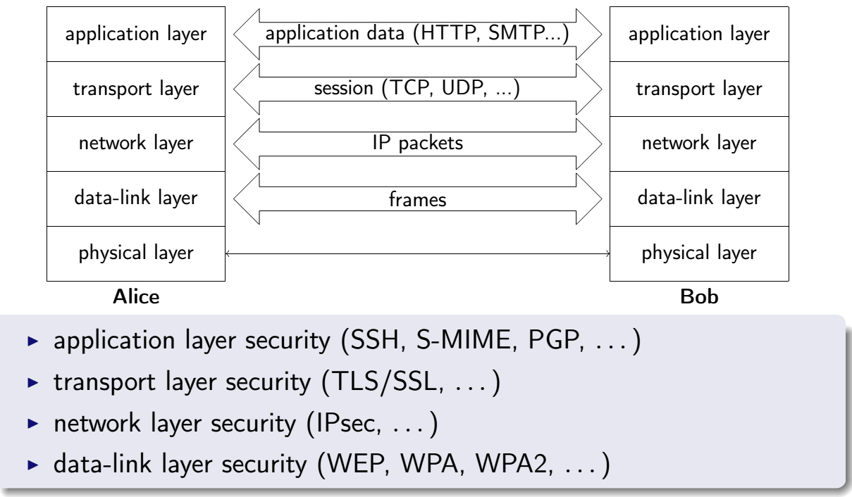
Kriptografi pada susunan tcp/ip
as

Slide 6
Masalah perlindungan lapis fisik
Hide signal
Spread spectrum
Emission security
Radio emissions (Tempest)
Power emissions

Slide 7
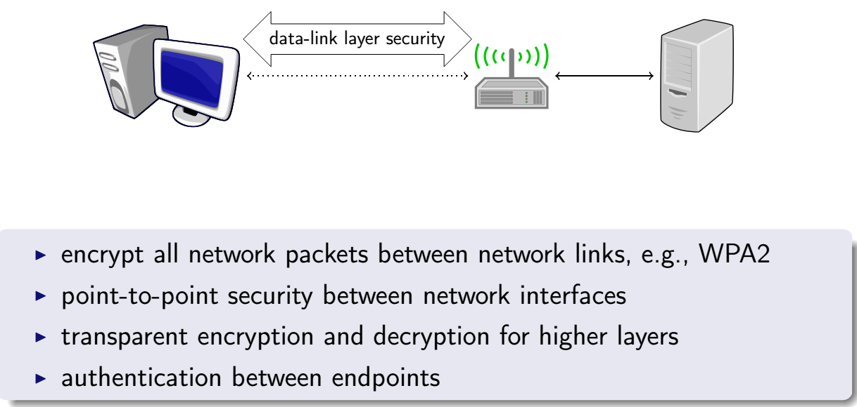
Keamanan lapis datalink
as

Slide 8
Enkripsi lapis datalink satu-hop
Host
Router
Router
Host
Application
Application
Transport
Transport
Network
Network
Network
Network
Link
Link
Link
Link
Link
Link

Slide 9
Enkripsi lapis datalink
Encrypted
Link
IP
TCP
Application
Link

Slide 10
Keamanan lapis datalink
Advantages:
Transparent to applications
Hardware solution possible
Can address especially vulnerable links (viz. wireless)
Disadvantages:
Hop-by-hop protection causes multiple applications of crypto operations
May not provide end to end security

Slide 11
Keamanan lapis jaringan
HTTP
FTP
SMTP
TCP
IP/IPSec

Slide 12
Mode Transpor lapis jaringan
Link
IP
TCP
Application
Link
Encrypted
Link
IP
Hdr
TCP
Application
Tlr
Link

Slide 13
Mode tunnel lapis jaringan
Link
IP
TCP
Application
Link
Encrypted
Link
New IP
Hdr
IP
TCP
Application
Tlr
Link

Slide 14
Pilihan lokasi kemanan jaringan
Application
Application
Transport
Transport
End-to-End Transport
Network
Network
Network
Network
Link
Link
Link
Link
Application
Application
Transport
Transport
Voluntary Tunnel
Network
Network
Network
Network
Link
Link
Link
Link
Application
Application
Transport
Transport
Involuntary Tunnel
Network
Network
Network
Network
Link
Link
Link
Link

Slide 15
Keamanan lapis jaringan
Advantages
Transparent to applications
Amenable to hardware
Flexible
Disadvantages
Makes routing more complex
Flexibility introduces policy management and compatibility challenges

Slide 16
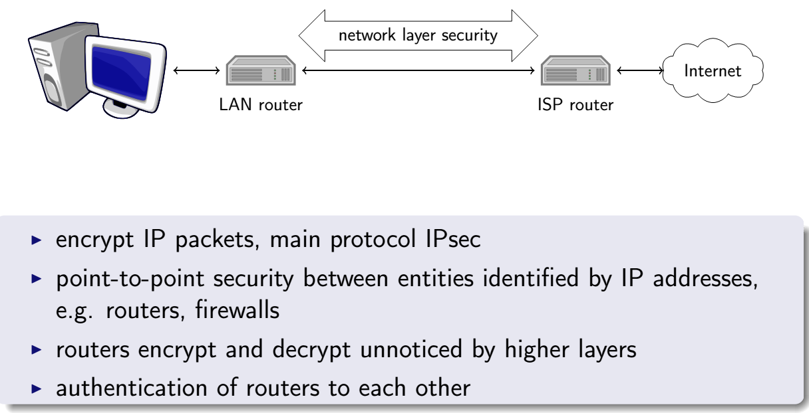
Keamanan lapis jaringan
as

Slide 17
Keamanan lapis transpor
HTTP
FTP
SMTP
SSL or TLS
TCP
IP

Slide 18
Enkripsi lapis transpor
Link
IP
TCP
Application
Link
Encrypted
Link
IP
TCP
RH
Application
Link
Link
IP
TCP
App
Link

Slide 19
Keamanan lapis transpor
Advantages
Transparent to applications and may be packaged with applications
Exposing TCP enables compression and QoS classification
Disadvantages
Probably implemented in software
Exposing TCP risks DoS

Slide 20
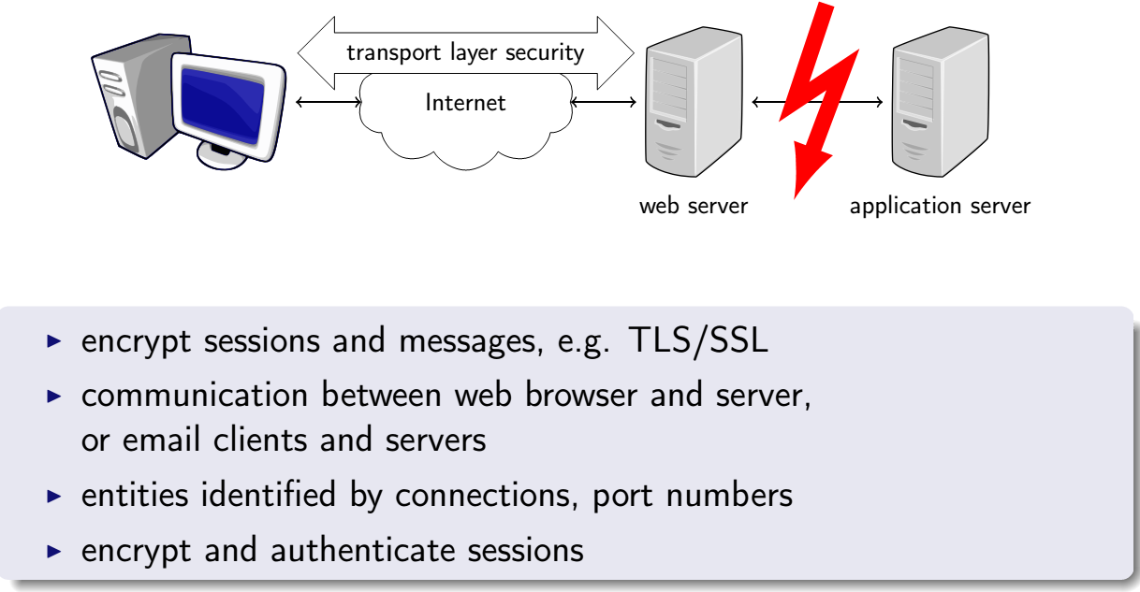
Keamanan lapis transpor
as

Slide 21
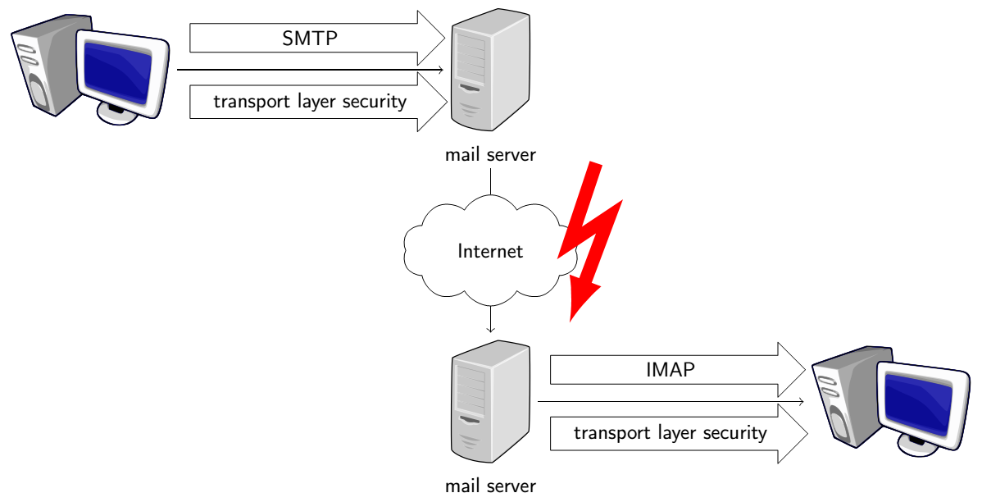
Keamanan lapis transpor
as

Slide 22
KEAMANAN LAPIS APLIKASI

Slide 23
Lapis Aplikasi
Provides services for an application to send and recieve data over the network, e.g., telnet (port 23), mail (port 25), finger (port 79)
Interface to the transport layer
Operating system dependent
Socket interface

Slide 24
Keamanan Lapis Aplikasi
Advantages:
Most flexible
Executing in the context of the user → easy access to user’s credentials
Complete access to data → easier to ensure nonrepudation and small security granularity
Application-based security
Disadvantages:
Most intrusive
Implemented in end hosts
Need for each application →
Expensive
Greated probability of making mistake

Slide 25
Keamanan Lapis aplikasi
S/MIME
PGP
SET
Kerberos
SMTP
HTTP
UDP
TCP
IP

Slide 26
Keamanan lapis aplikasi
Link
IP
TCP
Application
Link
Encrypted
Link
IP
Key ID
TCP
Application
Link

Slide 27
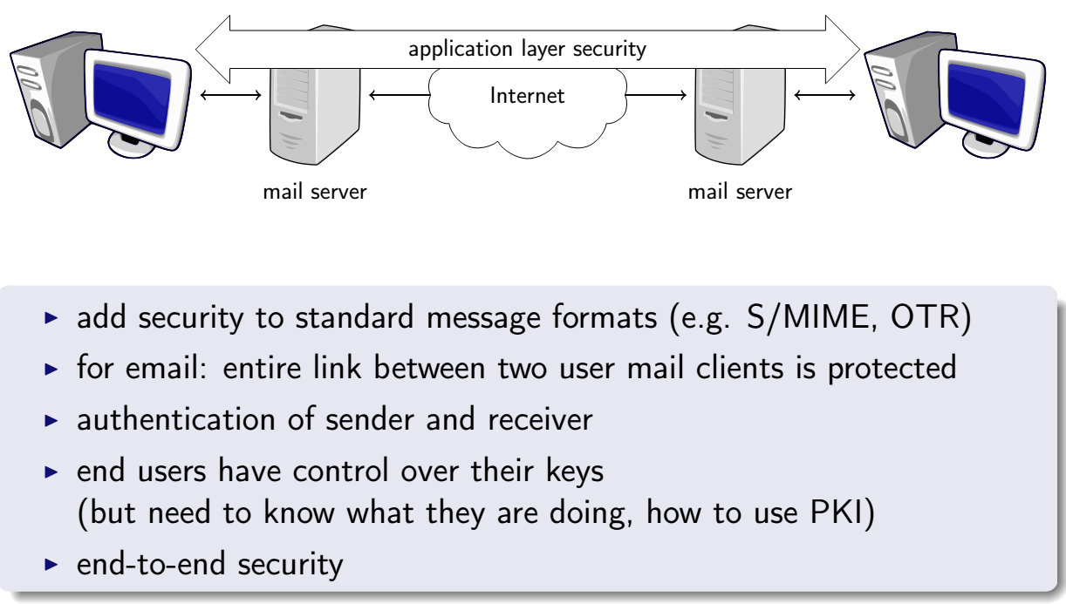
Keamanan lapis aplikasi
as

Slide 28
Penyediaan keamanan
Provide security system that can be used by different applications
Develop authentication and key distribution models
Enhance application protocol with security features
Need to enhance each application

Slide 29
Otentikasi dan penyebaran kunci
Kerberos (MIT) and its extensions (Secure European System for Application in a Multi-vendor Environment (SESAME))
Network Security Program (IBM)
SPX (Digital Equipment Corporation)
The Exponential Security System (University of Karlsruhe)

Slide 30
Komponen Kerberos
Key Distribution Center (KDC)
Authentication server (AS)
Ticket-granting server (TGS)
Database: users’ identifiers + secret kay shared between KDC and user
Need physical security

Slide 31
Sistem Tiket
KDC issues tickets that clients and servers can use to mutually authenticate themselves and agree on shared secrets.
Ticket:
Session key
Name of principal
Expiration time
Ticket types:
Ticket-granting ticket: issued by AS and used between client and TGS
Service ticket: issued by TGS and used between client and server

Slide 32
Kerberos
1.Request ticket-
granting ticket
Kerberos
Once per
user logon
session
2. Ticket +
session key
KDC
Client
3. Request service-
granting ticket
TGS
4. Ticket +
session key
Once per
type of
service
6. Provide server
authentication
5. Request service
Server
Once per
service
session

Slide 33
VERSI Kerberos
Version 4 (MIT) – 1992
Versions 1-3 were only used at MIT
Shortcomings and limited functionality (S. Bellovin and M. Merrit 1990)
Version 5 (RFC 1510) – 1993
Improves on version 4 shortcomings

Slide 34
PENGUATAAN KEAMANAN PROTOKOL APLIKASI
Applications:
Terminal access
File transfer
Electronic mail
WWW transactions
DNS
Distributed file system

Slide 35
AKSES TERMINAL
Protocols running on top of TCP/IP
Telnet: password based authentication
Rlogin: address-based authentication
Security enhanced Telnet
Kerberos-mediated Telnet encryption: difficult to achieve
Security-enhanced Telnet (e.g., Secure Telnet (STEL) Univ. Milan
Authentication enforced by STEL is stronger than Telnet
All data traffic is encrypted between client and server
Secure Shell (SSH)

Slide 36
SSH
Provides similar services than SSL
Mutual authentication
Encrypted sessions between two endpoints
Most often used to replace traditional terminal access → Application layer security
Any application running on top of TCP can be secured by SSH

Slide 37
VERSI SSH
SSH v1
Tatu Ylonen, Helsinki University of Technology, Finland
Implementation, source code, documentation, configuration scripts: public and freely available
Widespread use
SSH v2
Specified by IETF Secure Shell WG (1st draft: 1997)
Widespread use
Open source implementations: OpenSSH

Slide 38
SSH
Both version use generic transport layer security protocol over TCP/IP
Support for
Host and user authentication
Data compression
Data confidentiality
Integrity protection
Server listens for TCP connection on port 22, assigned to SSH

Slide 39
KUNCI V1 SSH
Host public key pair
Bind connection to the desired server host
Long-term
Long key size (typically 1,024 bit RSA)
Server public key pair
Provide confidentiality
Short-term
Short key size (typically 768 bit RSA)
Changes periodically (i.e., every hour by default)
For PFS server’s private key cannot be saved on disk

Slide 40
SESI SSH
Client → Server: Authentication request
Server → Client: Server public keys (long-term and short-term)
Client:
Compares received keys to its database of pre-distributed keys and (usually) accepts keys
Generates 256-bit random session key
Chooses encrypting algorithm
Pads session key
Double encrypts session key with server and host public keys

Slide 41
SESI SSH
Client → Server: Sends double encrypted session key
Server:
Decrypts session key
Server → Client: send confirmation encrypted by session key
Both parties use session key to encrypt traffic between server and client

Slide 42
KEAMANAN SURAT ELEKTRONIK

Slide 43
SURAT ELEKTRONIK
Most heavily used network-based application
Used across different architectures and platforms
Send e-mail to others connected directly or indirectly to the Internet regardless of host operating systems and communication protocols
NEED:
Authentication
Confidentiality

Slide 44
PENDEKATAN Secure E-mail
PGP: Pretty good Privacy
PEM: Privacy-Enhanced Mail
Secure Multipurpose Internet Mail Extensions (S/MIME)

Slide 45
Pretty Good Privacy
Phil Zimmermann
Confidentiality and authentication for
Electronic mail and
Storage applications

Slide 46
PENGGUNAAN PGP
PGP became widely used within a few years
Available worldwide for different platforms
Based on proven secure algorithms (RSA, IDEA, MD5)
Wide range of applicability
Was not developed or controlled by government standards

Slide 47
MENGAPA PGP?
Protect privacy
“I don’t need encryption!” = “I don’t need privacy.”
Interception transmission to destinations
Transparent mailbox (dial-up connection)
You may not but other party may want privacy
Commercial privacy
Customer’s data
Company data
User’s profiling
Signed messages
Authentication
Integrity
?

Slide 48
LAYANAN PGP
Digital Signature: RSA, MD5
Hash code of message is created using MD5, encrypted using RSA, with sender’s private key, and attached to the message
Confidentiality: RSA, IDEA
Message is encrypted using IDEA, with one-time session key generated by the sender, session key is encrypted, using RSA and the recipient’s public key, and attached to the message

Slide 49
LAYANAN PGP
Compression: ZIP
Message may be compressed for storage or transmission
E-mail compatibility: Radix 64 conversion
Encrypted message is converted to ACSII string
Segmentation
To accommodate maximum message size, PGP performs segmentation and reassembly

Slide 50
OTENTIKASI
K^{A}_{private}
H(M)
E
K^{A}_{private}[H(M)]
H
H
M
M
c
Compare
M
concatenate
D
K^{A}_{private}[H(M)]
K^{A}_{public}
Receiver B
Sender A

Slide 51
OTENTIKASI
RSA and MD5: effective digital signature schema
Default: signatures attached to messages
Support detached signatures
User may want to maintain separate signature files
Detect virus infection of executable programs
Support multiple signature of a message

Slide 52
KERAHASIAAN
K_{session}
K_{session}(M)
K_{session}(M)
E
E
M
M
concatenate
c
E
K^{B}_{public} (K_{session})
D
K_{session}
K_{session}
K^{B}_{public} (K_{session})
K^{B}_{public}
K^{B}_{private}
Receiver B
Sender A

Slide 53
KERAHASIAAN
IDEA: secret-key encryption
Key-distribution:
randomly generated, one-time session keys
Encrypted by receiver’s public key
Attached to the message
Double encryption
IDEA
One-time key
RSA key size:
Casual: 384 bits
Commercial: 512 bits
Military: 1024 bits

Slide 54
KERAHASIAAN DAN OTENTIKASI
Sender A
K^{A}_{private}
K^{B}_{public}
K_{s}[M+H(M)]
K_{s}
E
H
E
M
M
c
E
c
K^{A}_{private}[H(M)]
K^{B}_{public} (K_{s})
H
D
Compare
K_{s}
D
D
K^{B}_{private}
K^{A}_{public}
Receiver B

Slide 55
KOMPRESI
Usually after signature and before encryption
Preferable to sign uncompressed message -> store them together for future verification
PGP’s compression algorithm is not deterministic
Encryption after compression strengthen cryptographic security (less redundancy)

Slide 56
KOMPATIBILITAS E-mail
PGP encryption: arbitrary 8-bit binary stream
Several e-mail system: ASCII text
PGP: converts the binary stream to a stream of printable ASCII characters
Expands the message by 33%
Converts everything, regardless of content (even ASCII characters)

Slide 57
Latihan
Soal 1:
PGP menggunakan mode umpan balik cipher (CFB) CAST-128, walaupun kebanyakan aplikasi enkripsi simetris lainnya (selain enkripsi kunci) menggunakan rantai blok cipher (CBC) sebagai berikut:
CBC: C_{i} = E(K,[C_{i-1}⊕P_{i}]); P_{i} = C_{i-1}⊕D(K,C_{i})
CFB: C_{i} = P_{i}⊕E(K,C_{i-1}); P_{i} = C_{i}⊕E(K,C_{i-1})
Kedua rumus tersebut menghasilkan tingkat keamanan yang sama. Jelaskan alasan mengapa PGP menggunakan mode CFB!

Slide 58
References
C. Farkas, “Application Layer Security”, University of South Carolina, 2014
C.A. Gunter, “Network Security Architectures”, University of Pennsylvania, 2004
R. Niederhagen, “IPSec and SSL/TLS”, Eindhoven University of Technology, 2015

Slide 59
TERIMA KASIH

