Slide 1
OVERVIEW CDMA 2000, CDMA 2000 1X EV, W-CDMA

Slide 3
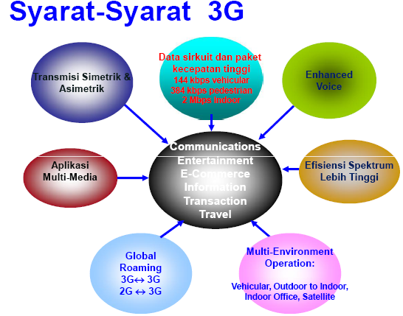

Slide 5
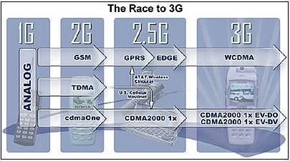

Slide 11
*MAP = Mobile Application Part , ex: SS7 uses to HLR,VLR, dll

Slide 12
Jenis Kanal

Slide 16
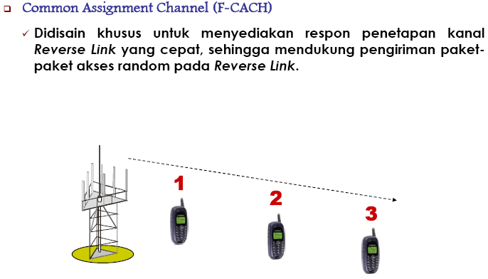

Slide 20
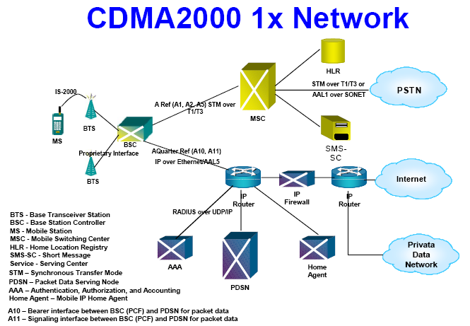

Slide 22
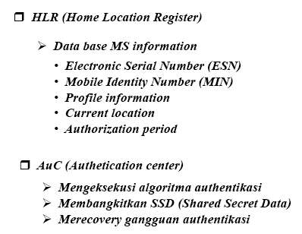

Slide 23
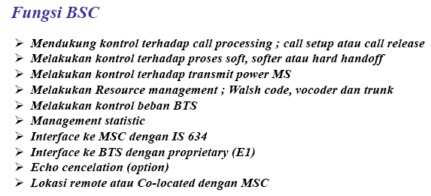

Slide 24
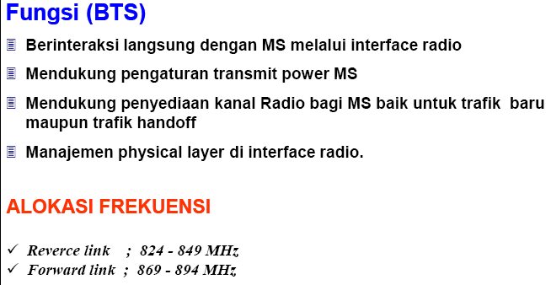

Slide 26
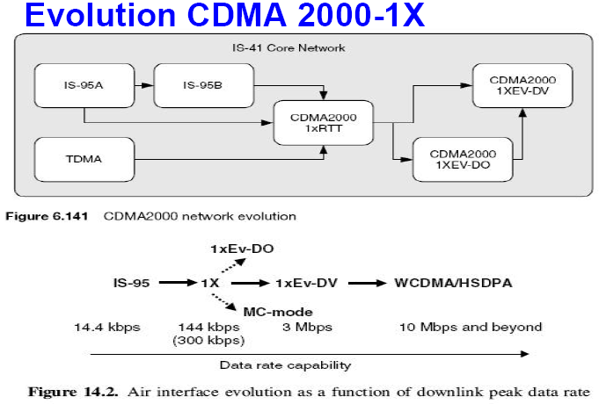

Slide 34
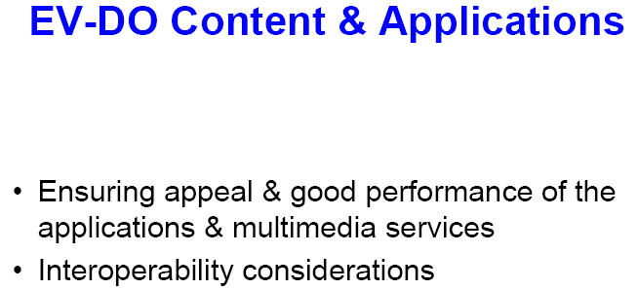

Slide 35
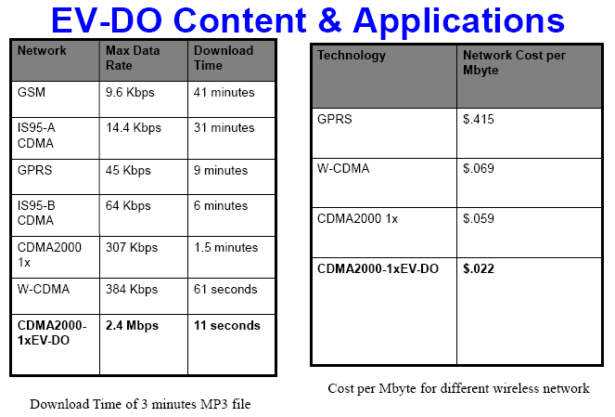

Slide 37
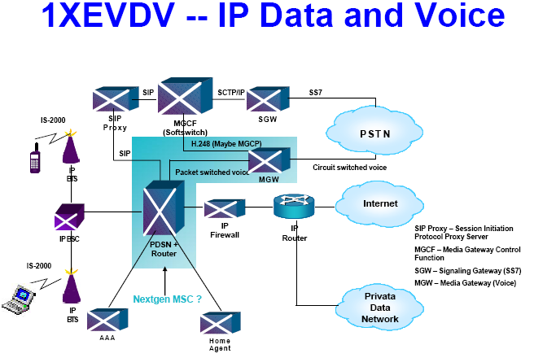

Slide 39
